Slide 1





DBMS Capstone Project Review-1 2026-27
Bank Account Management System
  Presented by:
  25B11AI316 – G.Sashank
  25B11AI340 – G.Manoj
  25B11AI520 – V.Pavithra
  25B11AI527 – B.Harika
Guided by:
G L Narasamba Vanguri
Department : Artificial Intelligence and Machine Learning

Slide 2
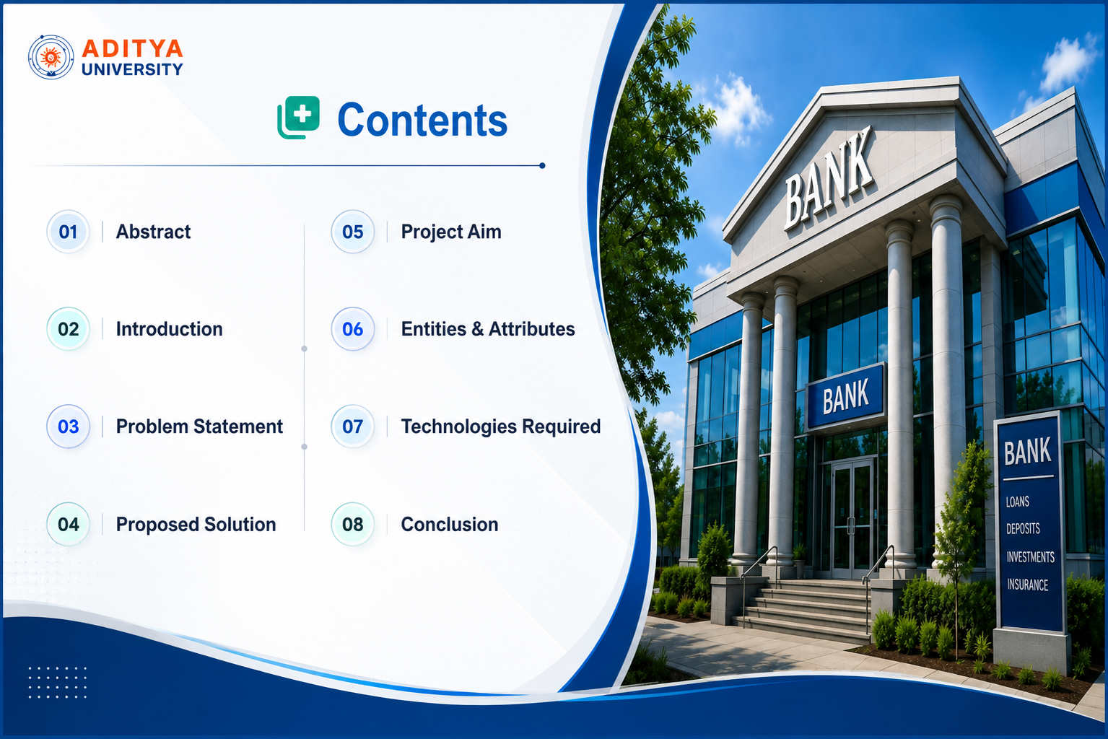

Slide 3



Introduction
What is a Bank Account Management System?
A Bank Account Management System is a database-based application used to store and manage customer and account information for a bank
Why DBMS in Bank System?
Ensures data accuracy and integrity
Supports safe money transfer transactions
Handles many users simultaneously
Reduces data redundancy, duplication
Provides strong security and access control

Slide 4
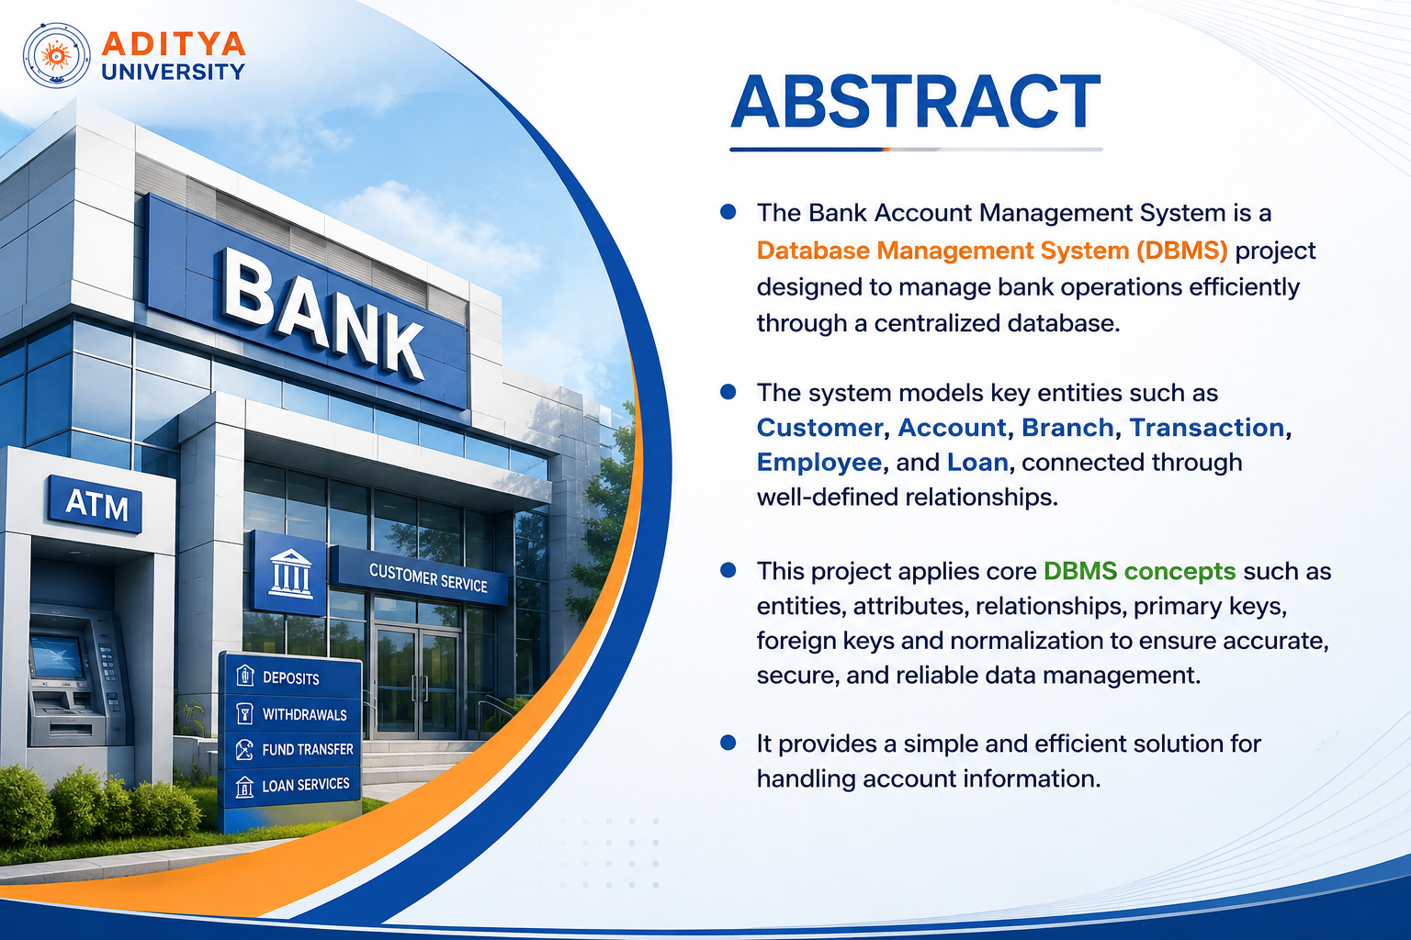


Slide 5
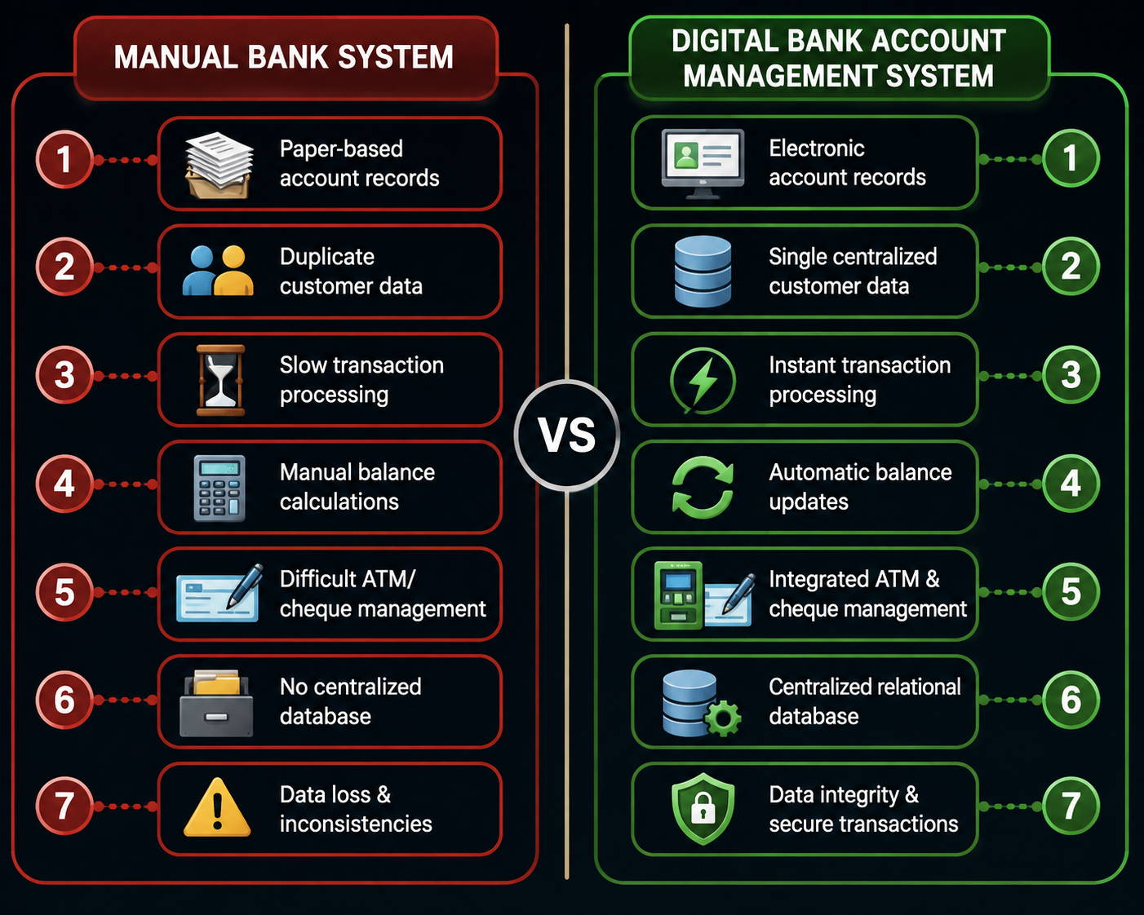

Problem Statement
Manual banking processes introduce critical inefficiencies that compromise transaction accuracy and financial security.
Key Challenges
Paper-based records prone to loss and damage
Duplicate customer entries causing data inconsistency
Slow manual retrieval delaying transaction processing
Billing errors from manual calculations
No centralized database for cross-branch access

Slide 6
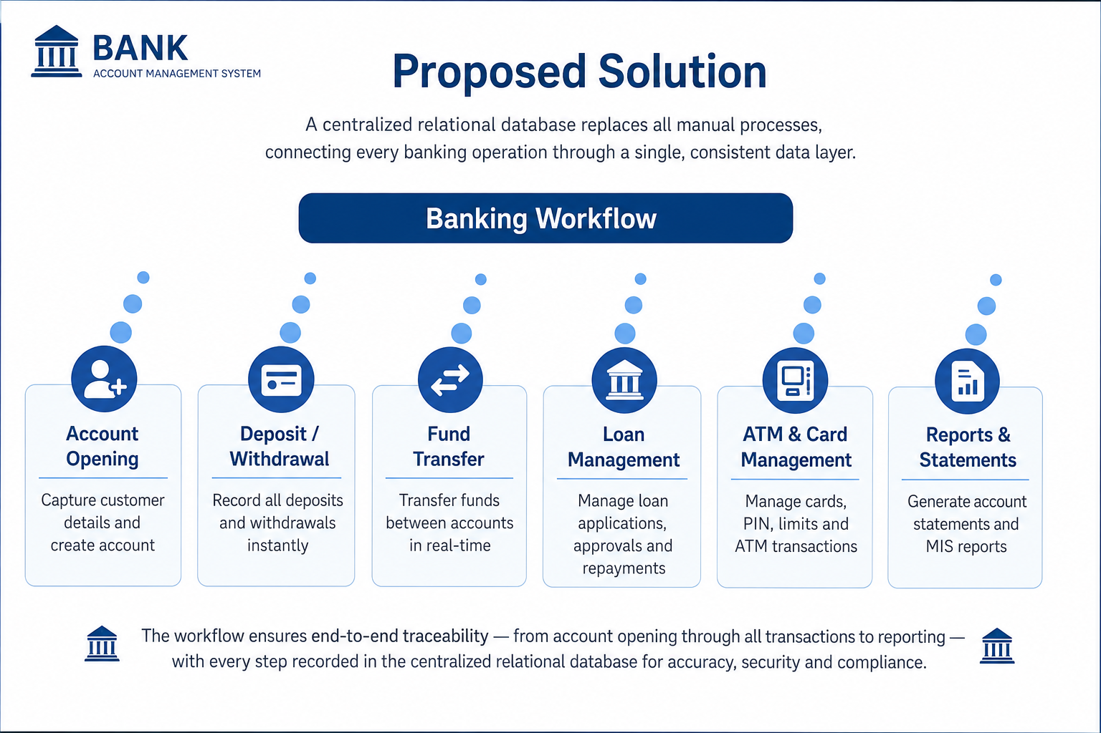




Slide 7
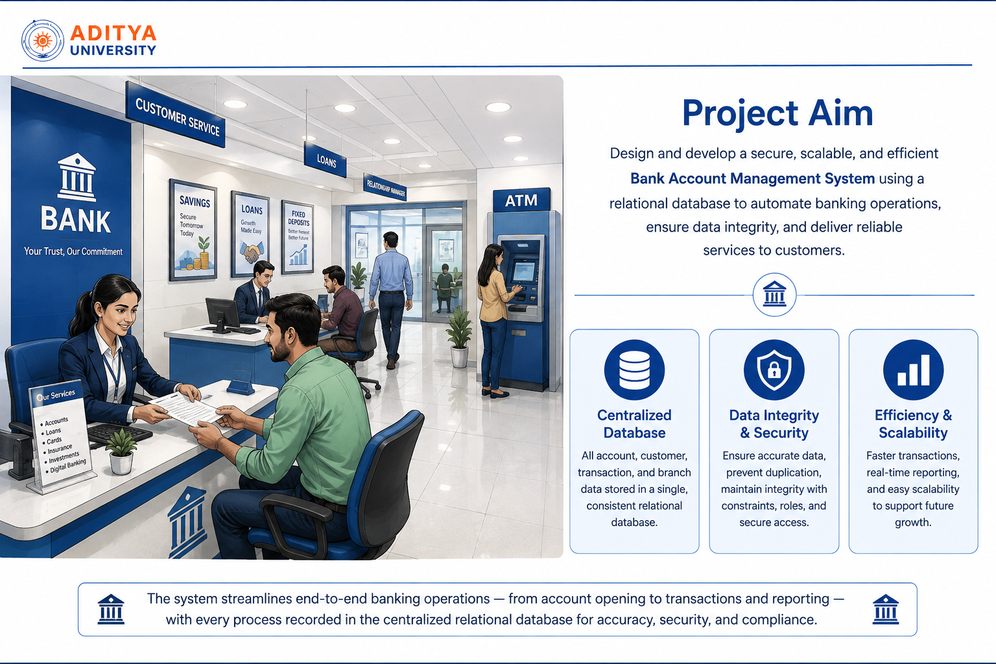

Slide 8

Entities & Attributes
The relational model comprises 10 core entities. Primary Keys (PK) uniquely identify records; Foreign Keys (FK) enforce referential integrity across relationships.
Entity
Primary Key
Key Foreign Keys
Branch
branch_ID (PK)
—
Customer
customer_ID (PK)
__
Accounts
account_ID (PK)
Customer_ID(FK), branch_ID(FK)
Transactions
transaction_ID (PK)
account_ID (FK)
Employees
employee_ID (PK)
branch_ID (FK)
Loans
loan_ID (PK)
account_ID (FK), employee_ID(FK)
Cards
card_ID (PK)
account_ID (FK)
Notifications
Notification_ID (PK)
customer_ID (FK)
Fixed_deposits
fd_ID (PK)
account_ID (FK)
Kyc_documents
document_ID (PK)
customer_ID (FK)

Slide 9
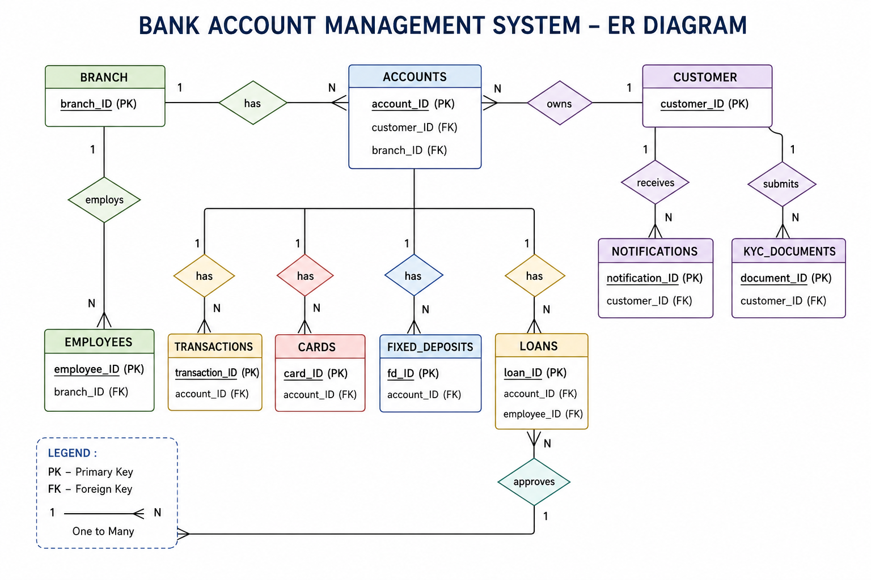
ER - DIAGRAM

Slide 10





Technologies Required
MySQL & SQL
Relational database engine and query language
MySQL Workbench
Schema design, visualization, and administration
Draw.io
ER diagrams, system flowcharts and also for database architecture
Microsoft PowerPoint
Project documentation and review presentation

Slide 11
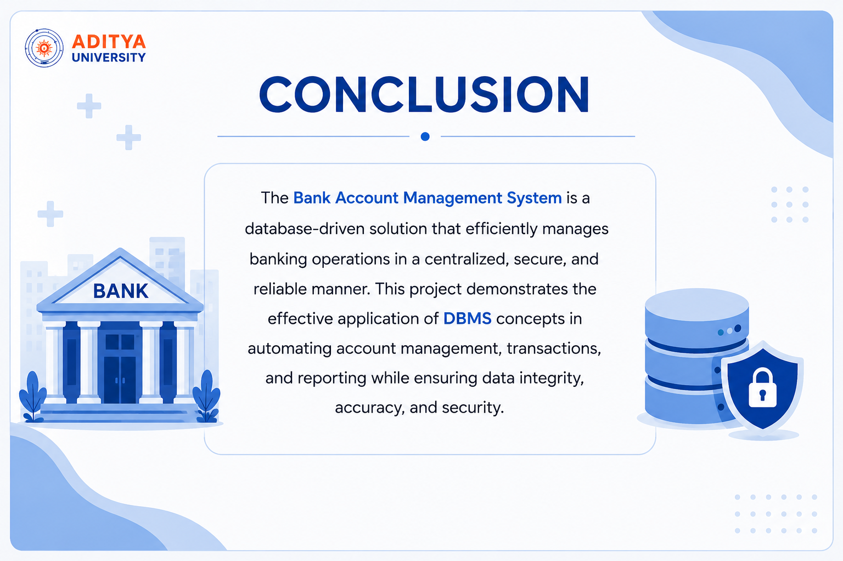

Slide 12


